Slide 1

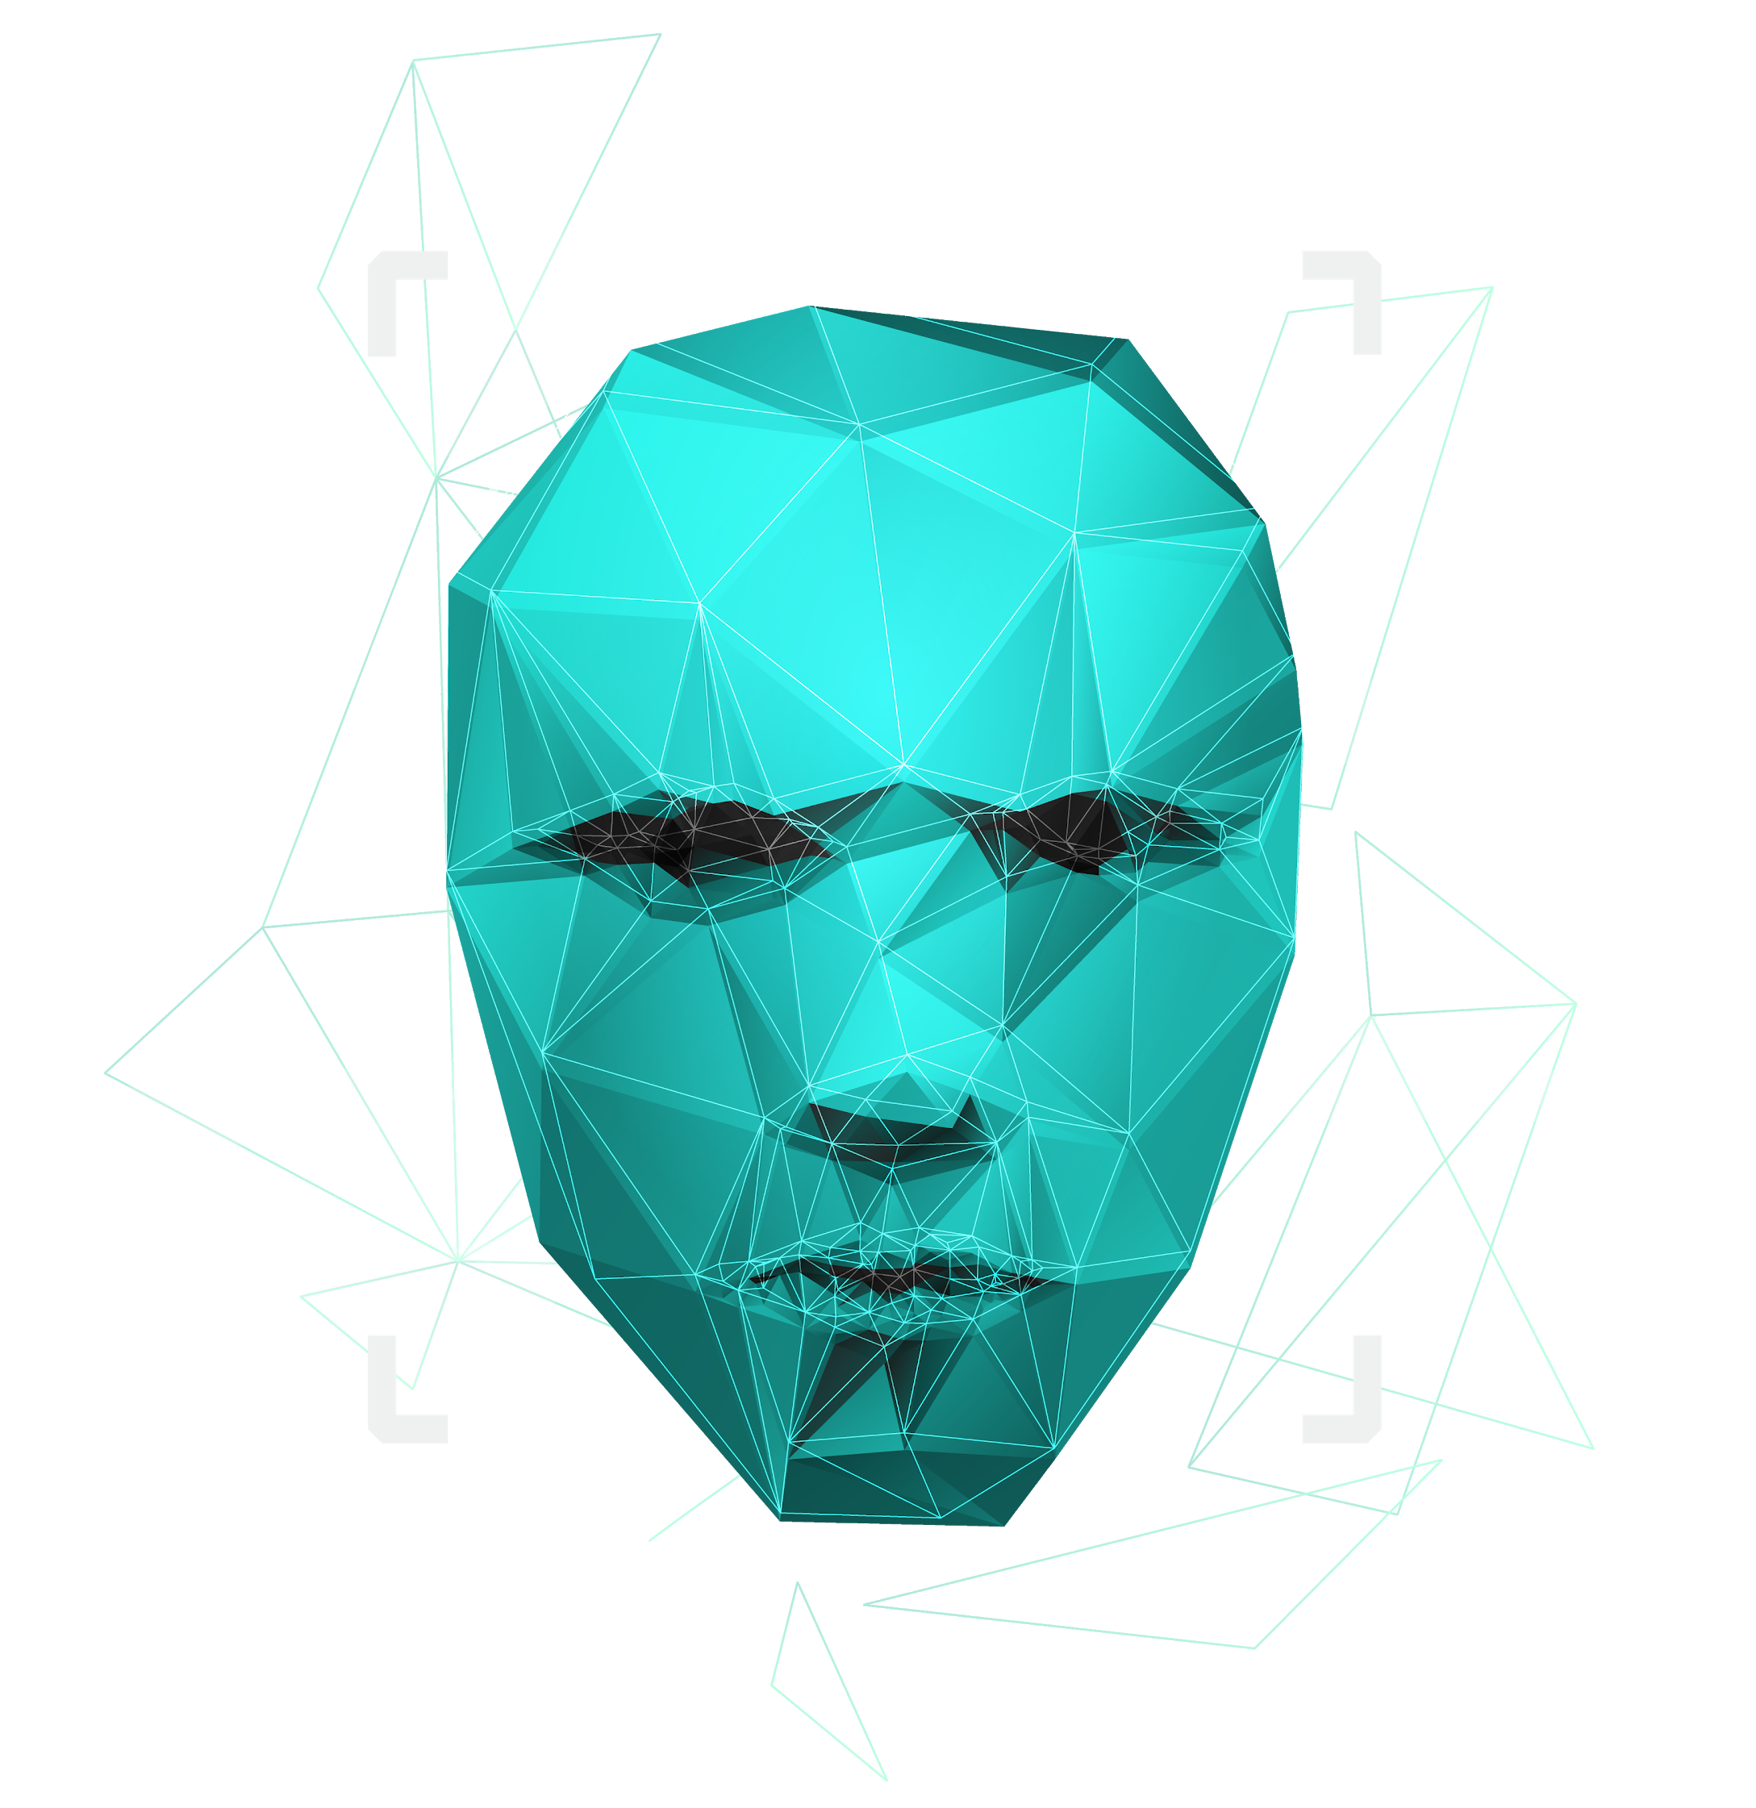
Paternity testing using genetics
Supervised by : Dr. Ashraf Abdelraouf & Eng. Ahmed Hazem

Slide 2

Agenda
Introduction & Objectives
Problem Statement
System Overview
Methodology
Design Patterns
Diagrams
Dataset Description
User Interface
Results
Time plan
Demo

Slide 3

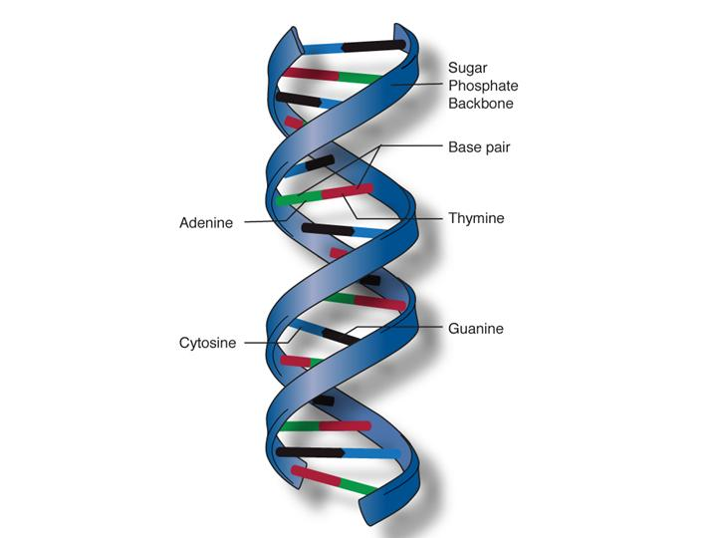
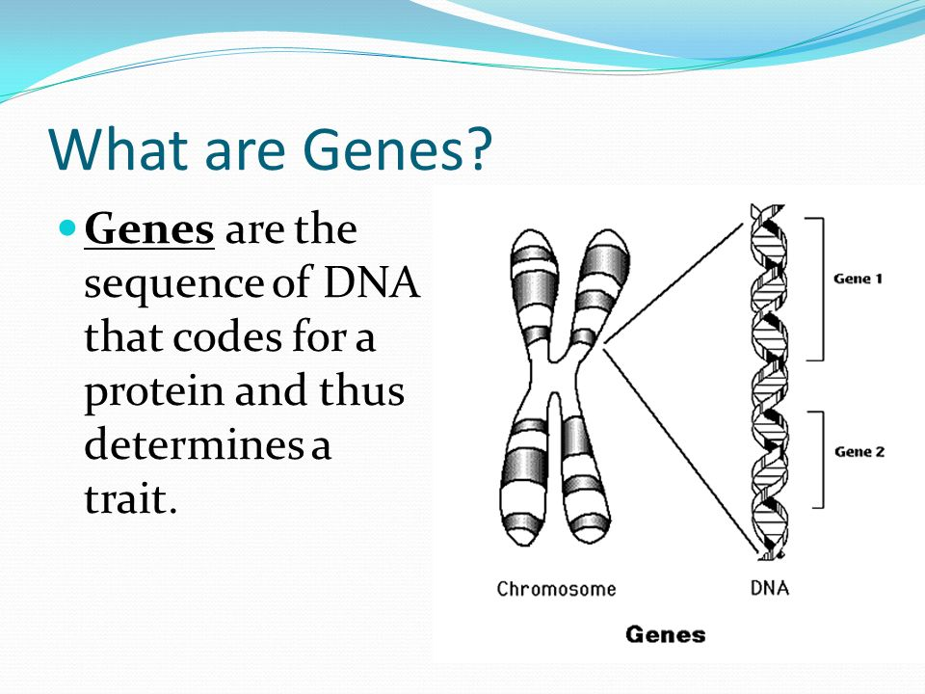
Introduction
DNA
DNA molecules allow this information to be passed from one generation to the next.
Genes →Genes are passed from parents to offspring and contain the information needed to specify traits(qualities). Genes contains a subset of the DNA and this subset is (A, T, C, G).
1

Slide 4
Introduction
Paternity Testing
Rs numbers using Mendelian’s Law
Whole Genome using STR
Algorithm
2

Slide 5
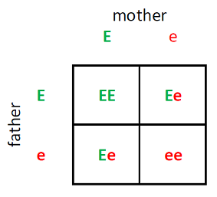
Introduction
What is an rsNumebr?
It is a reference number to the gene we have that consists of two alleles (one from the father and the other from the mother).
EX:
RsNumber | Father | Mother | Child1 | Child2 | Child3
rs3131972 | AG | GG | AG | GG | GG
3

Slide 6
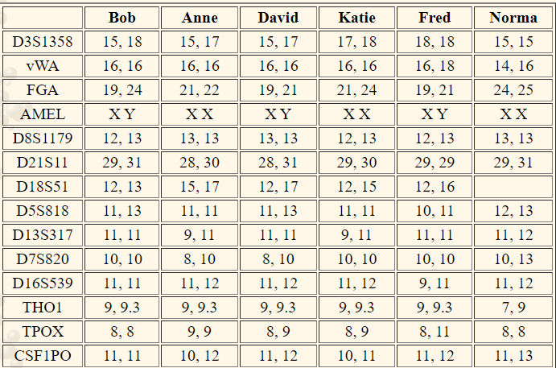
Introduction
Whole genome
It is the whole DNA sequence that a human have in their system.
Each number in the Table represents the repeats of nucleotide. Ex:
ATCGATCGATCGATCGATCGATCGATCGATCGATCGATCG
4

Slide 7


Problem Statement
Some parents suffer from the process of paternity testing when they are being sued for child custody.
A lot of time when a crime happens, some DNA would be left at the crime scene and would take some time to be processed and eventually lead us to the one who committed that crime.
Why can’t we have a system that could potentially prove this in less time and be accessible to everyone.
5

Slide 8
Our Objectives
Make an automated system to accurately prove parentage of someone by their Rs numbers and their genotypes.
Add another part to enter the user’s whole genome .
Implement a section for relevance using Rs numbers
We aim to implement our system in two parts: GUI system used by Government Clients and Mobile application used by users.
We aim that the user can see which alleles contributed to being wrong that led to prove wrong parentage.
6

Slide 9
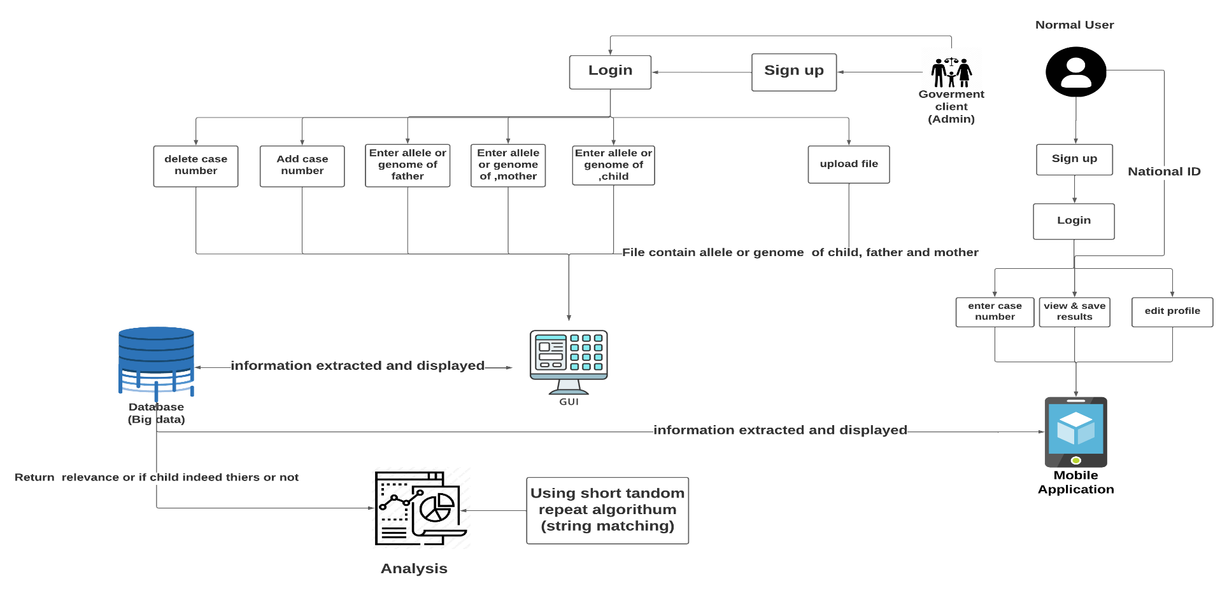
System overview
7

Slide 10
Methodology
Methodology
Apply Mendelian’s Law to prove that if the child is related to father or not
Whole Genome using STR
Algorithm
(Rs similar between father and child / all Rs numbers) * 100
Using short tandem repeat method to
count the repeats nucleotide in the whole genome
8

Slide 11
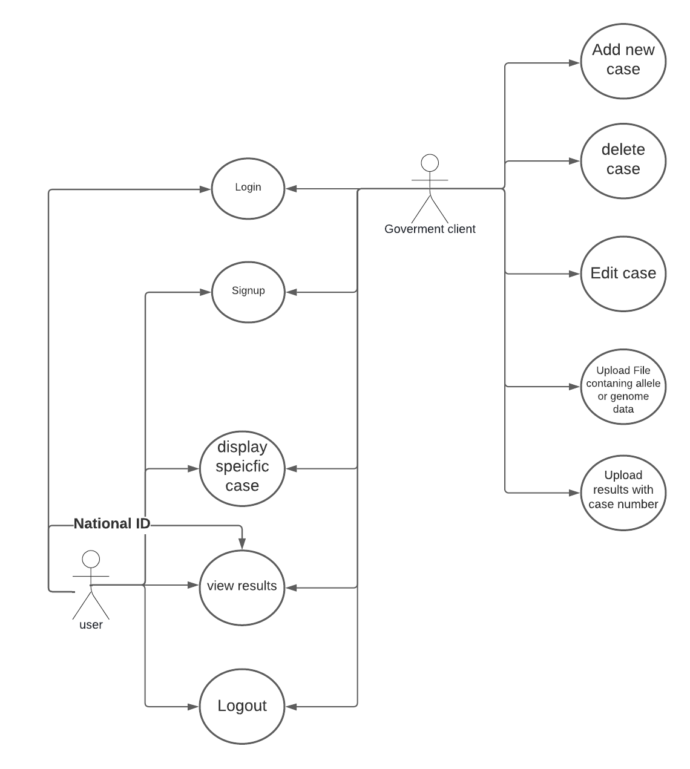
Use Case Diagram:
The system can accept files from the user containing their genotypes.
The system can save the user’s data (genotypes) (results)
The user can input their genotypes and get a report showing which genotypes contribute to the paternity test.
The user can see which alleles are different if it was proven wrong.
Rewrite this part
9

Slide 12
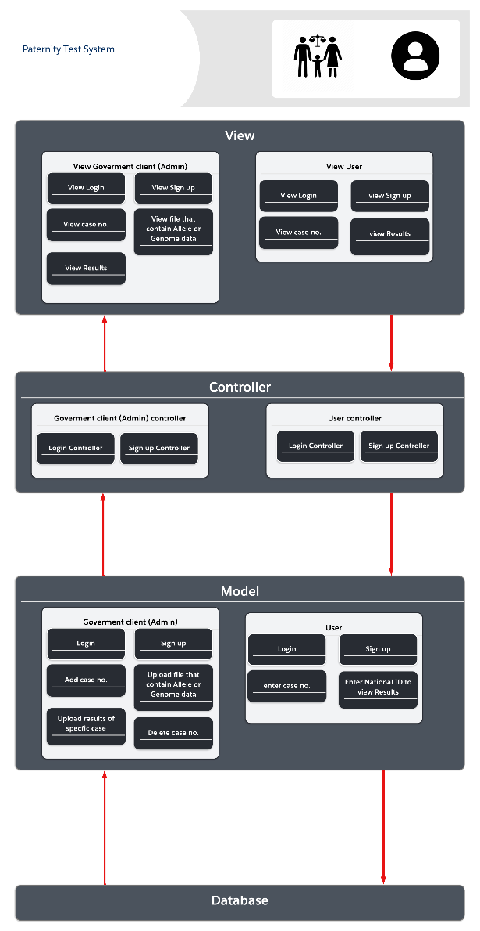
Diagrams Architecture Diagram
10

Slide 13
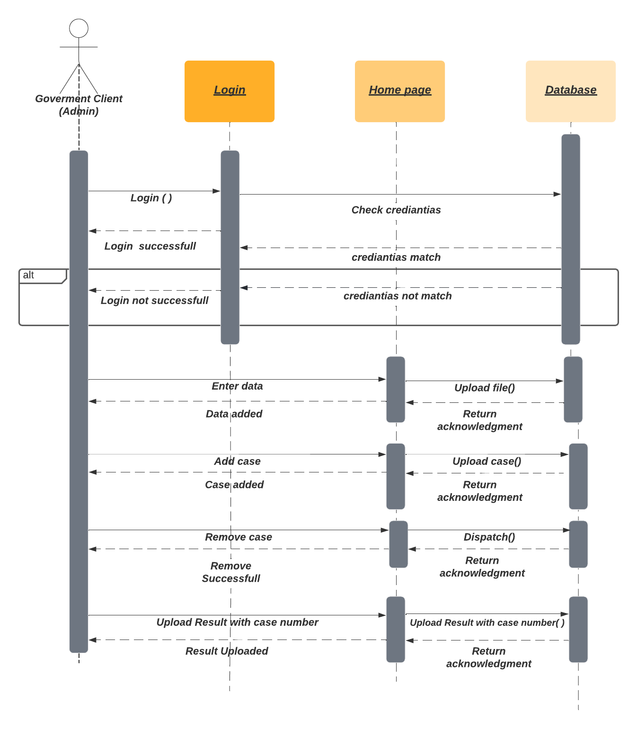
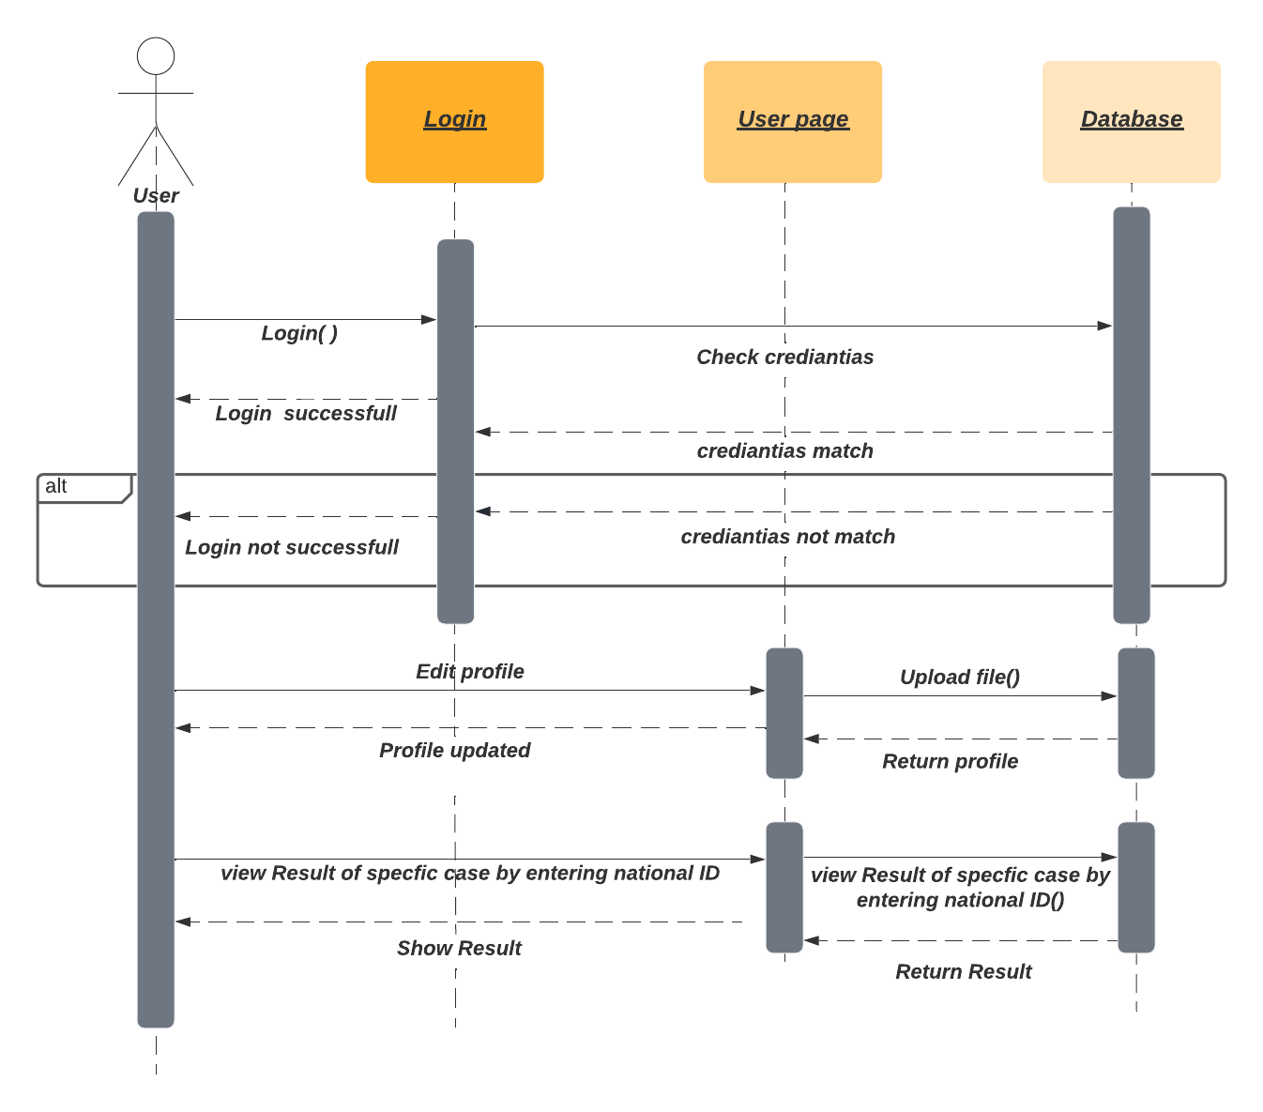
Diagrams Sequence diagrams
11

Slide 14
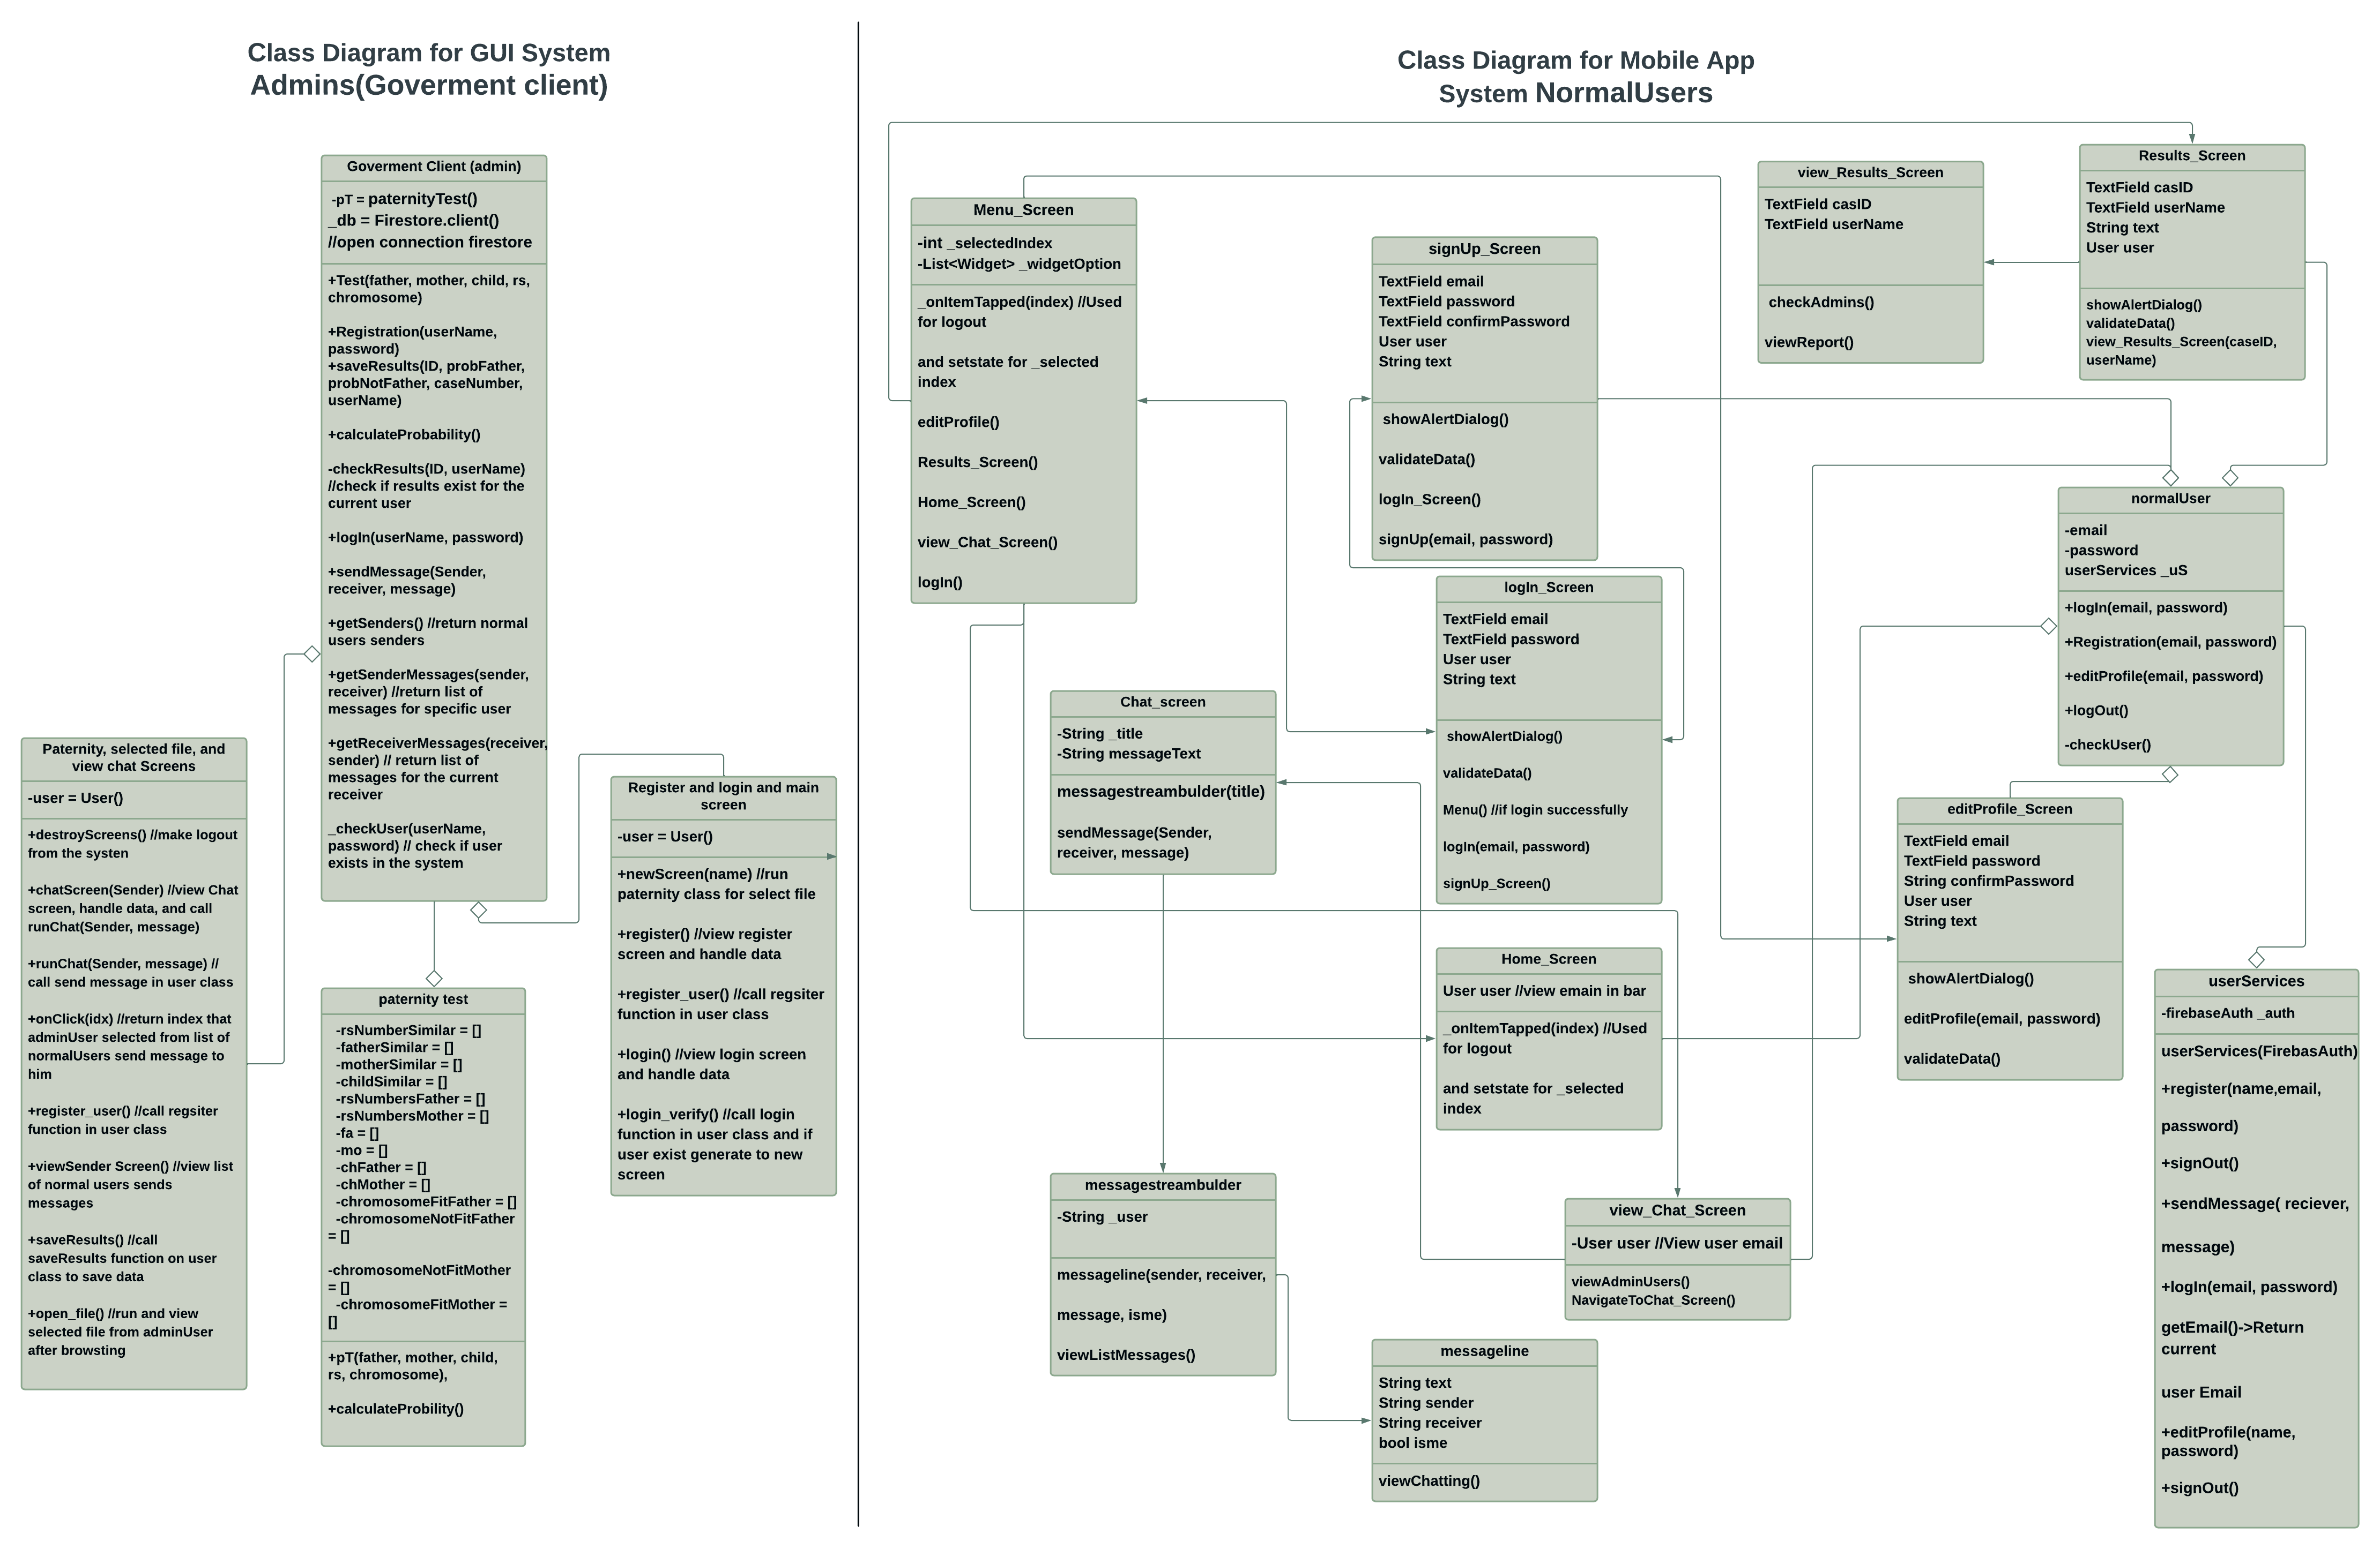
Diagrams
Class diagram:
12

Slide 15
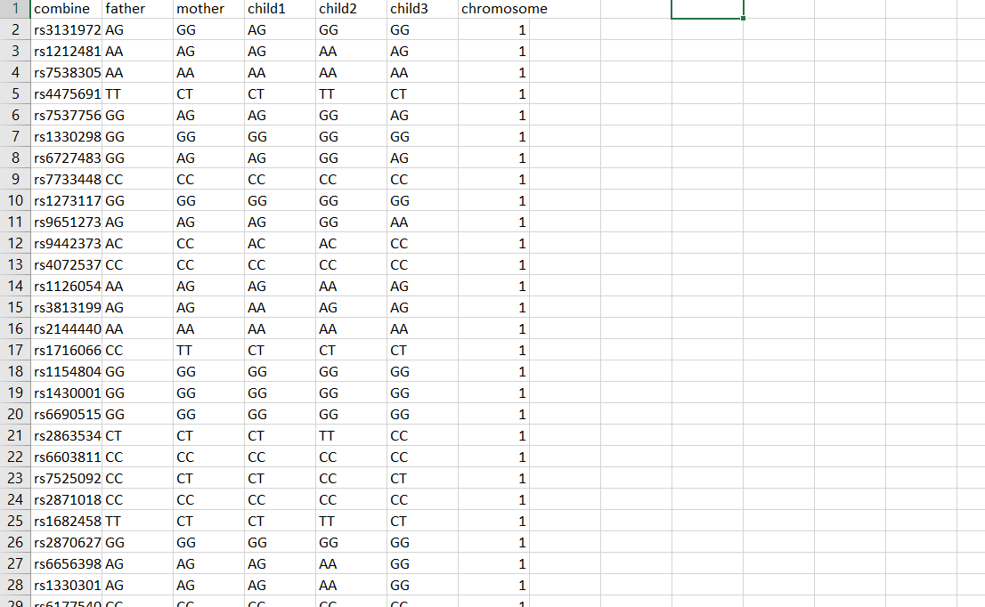
Dataset Used:
Our dataset has over 100000 instances of Rs numbers and consists of 6 main features showing both alleles for every family member and the number of chromosome for each instance
13

Slide 16
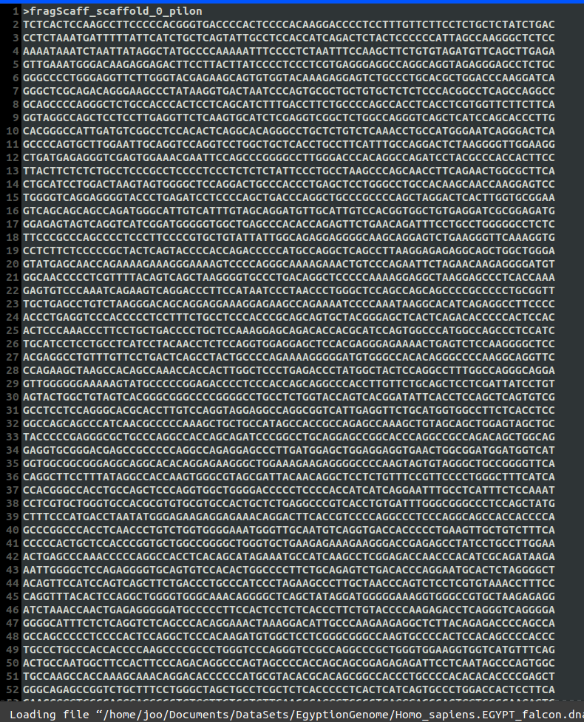
Dataset Used
In the whole genome the process to determine paternity is somewhat different There are specific locations (IDs) or the right terminology (locus, loci) in the whole genome every location and is in a specific chromosome For each of these locations, there exists a specific repeat that we are looking for ex: D7S280 --> GATA counting the number of those repeats for each location is the goal and then comparing it with the number of repeats in the mother and father
14

Slide 17
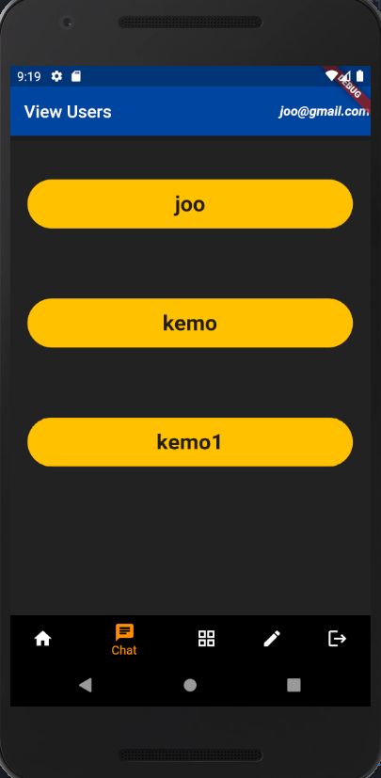
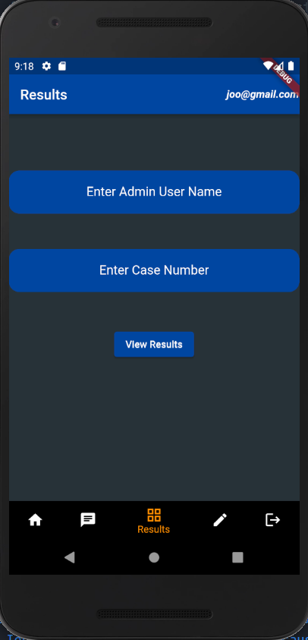
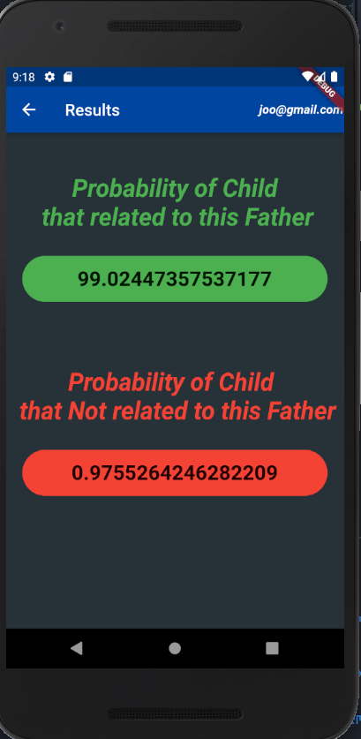
User interface
Mobile application
15

Slide 18
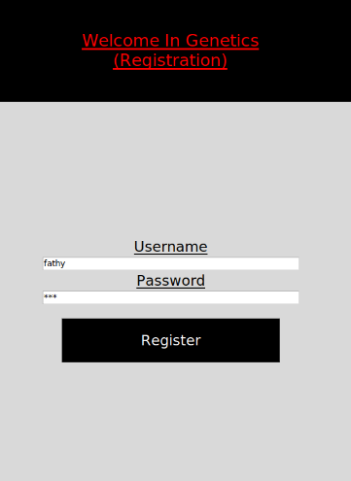
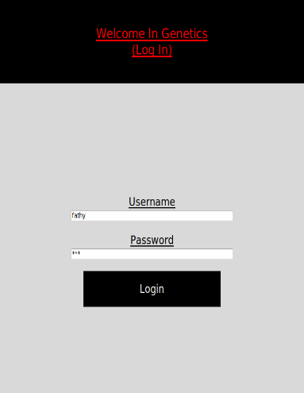
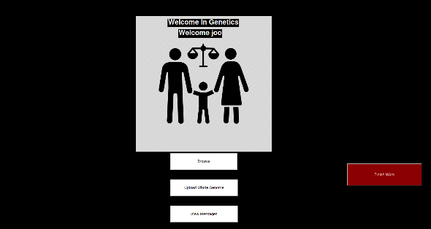
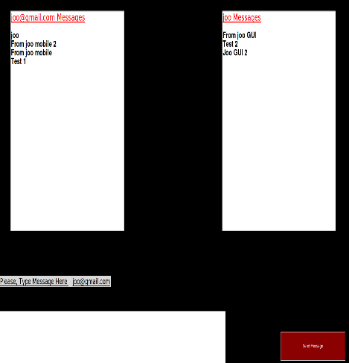
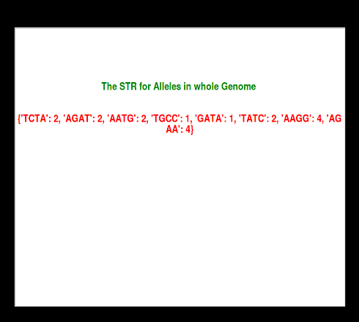
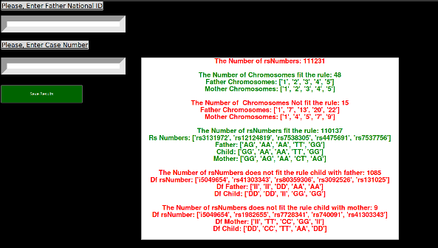
User interface (cont.)
GUI
16

Slide 19
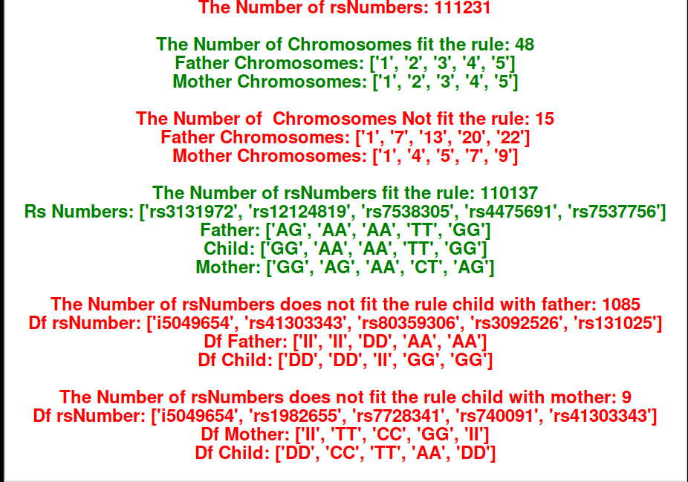
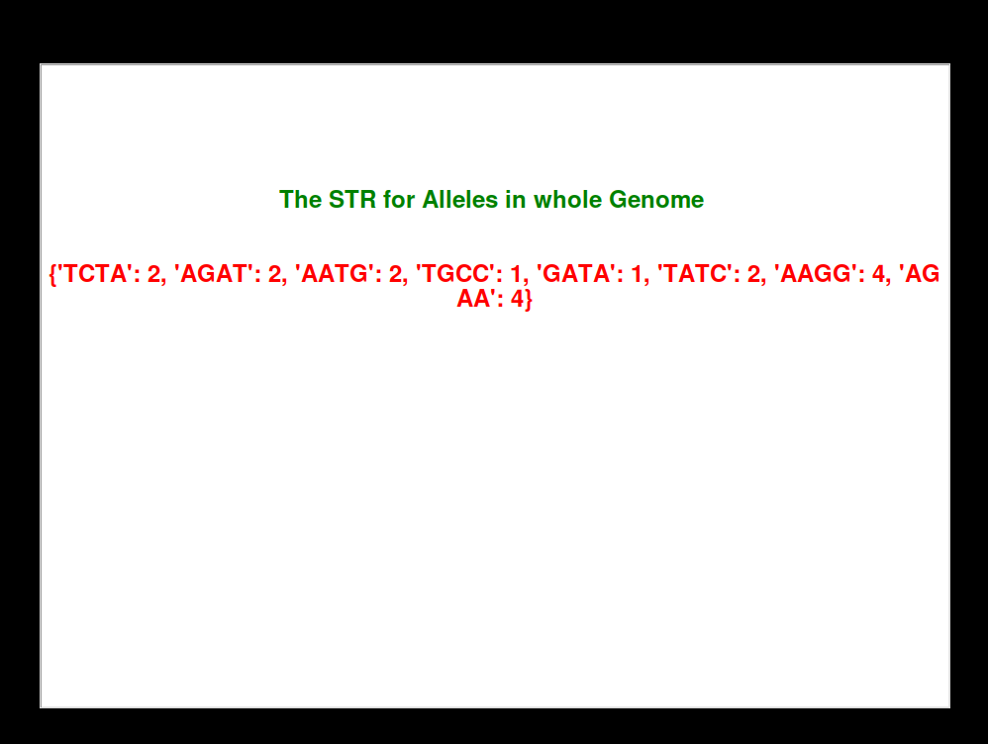
Results
Rs numbers report
Whole genome report
17

Slide 20
TIME PLAN
Try to collect whole genome family and apply the paternity test on, and collect rs numbers for relevance analysis
13/1/2022
Enhance everything we implemented so far
12/3/2022
Whole genome processing from the sources we gathered
By the end of January
Get the STR for each chromosome and compare between father and child
Start of April
Potentially add Whole genome in our system based on the information we gathered
By the end of February
Get relevance between new child and all fathers we have using rs numbers and whole genome
Middle of April
Implement at least 60 % of the GUI application and mobile application
Before the end of Februrary
Start by the end of February
Prove that if is at least a relevance or kinship degree
End of April
Finish the prototype of our system
18

Slide 21
Live Demo
19

Slide 22
THANK You!
Do you have any questions? ☺

